Slide 1
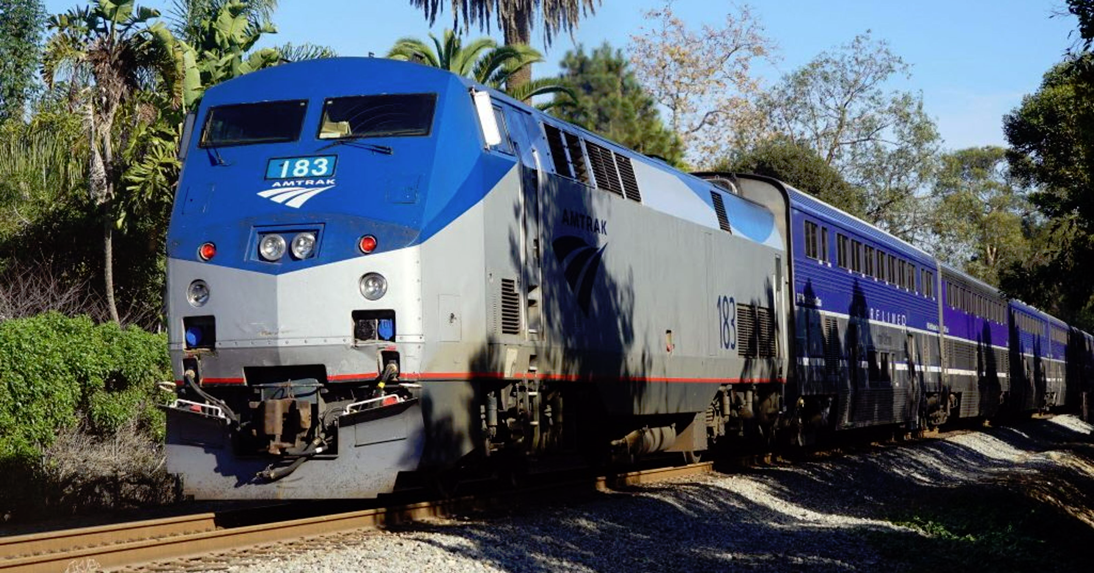
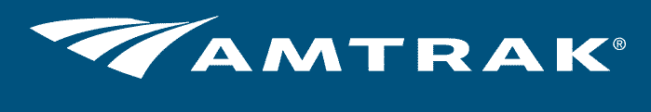
By: Julia Yeung and Chien-Ho Ma

Slide 2
Amtrak Overview
National Railroad Passenger Corporation
More than 500 destinations in 46 states
Operates more than 300 trains daily
Reserved/Unreserved Coach, Business Class, First Class
The Northeast Corridor (NEC) is the centerpiece:
Boston, MA; Providence, RI; New York, NY; Philadelphia, PA;
Washington D.C.; Newport News/Norfolk, VA

Slide 3
Amtrak - SWOT Analysis
Strengths | Weaknesses
Dominant passenger carrier Extensive operational network | Financial dependence on Federal support Regular disruptions and delays
Opportunities | Threats
Growing railroads sector in the US Growth in the US rail freight market | Intense competition from alternatives Governmental regulations

Slide 4
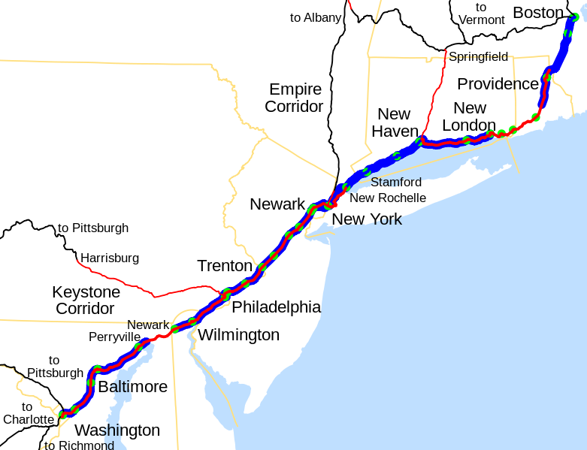
Objectives
Business Objective Grow ticket sales for the Amtrak Northeast Region by 5% over the next 12 months.
Marketing Objective Achieve awareness of the services available and get customers to consider Amtrak service over alternatives.
Notes:
Julia Yeung

Slide 5
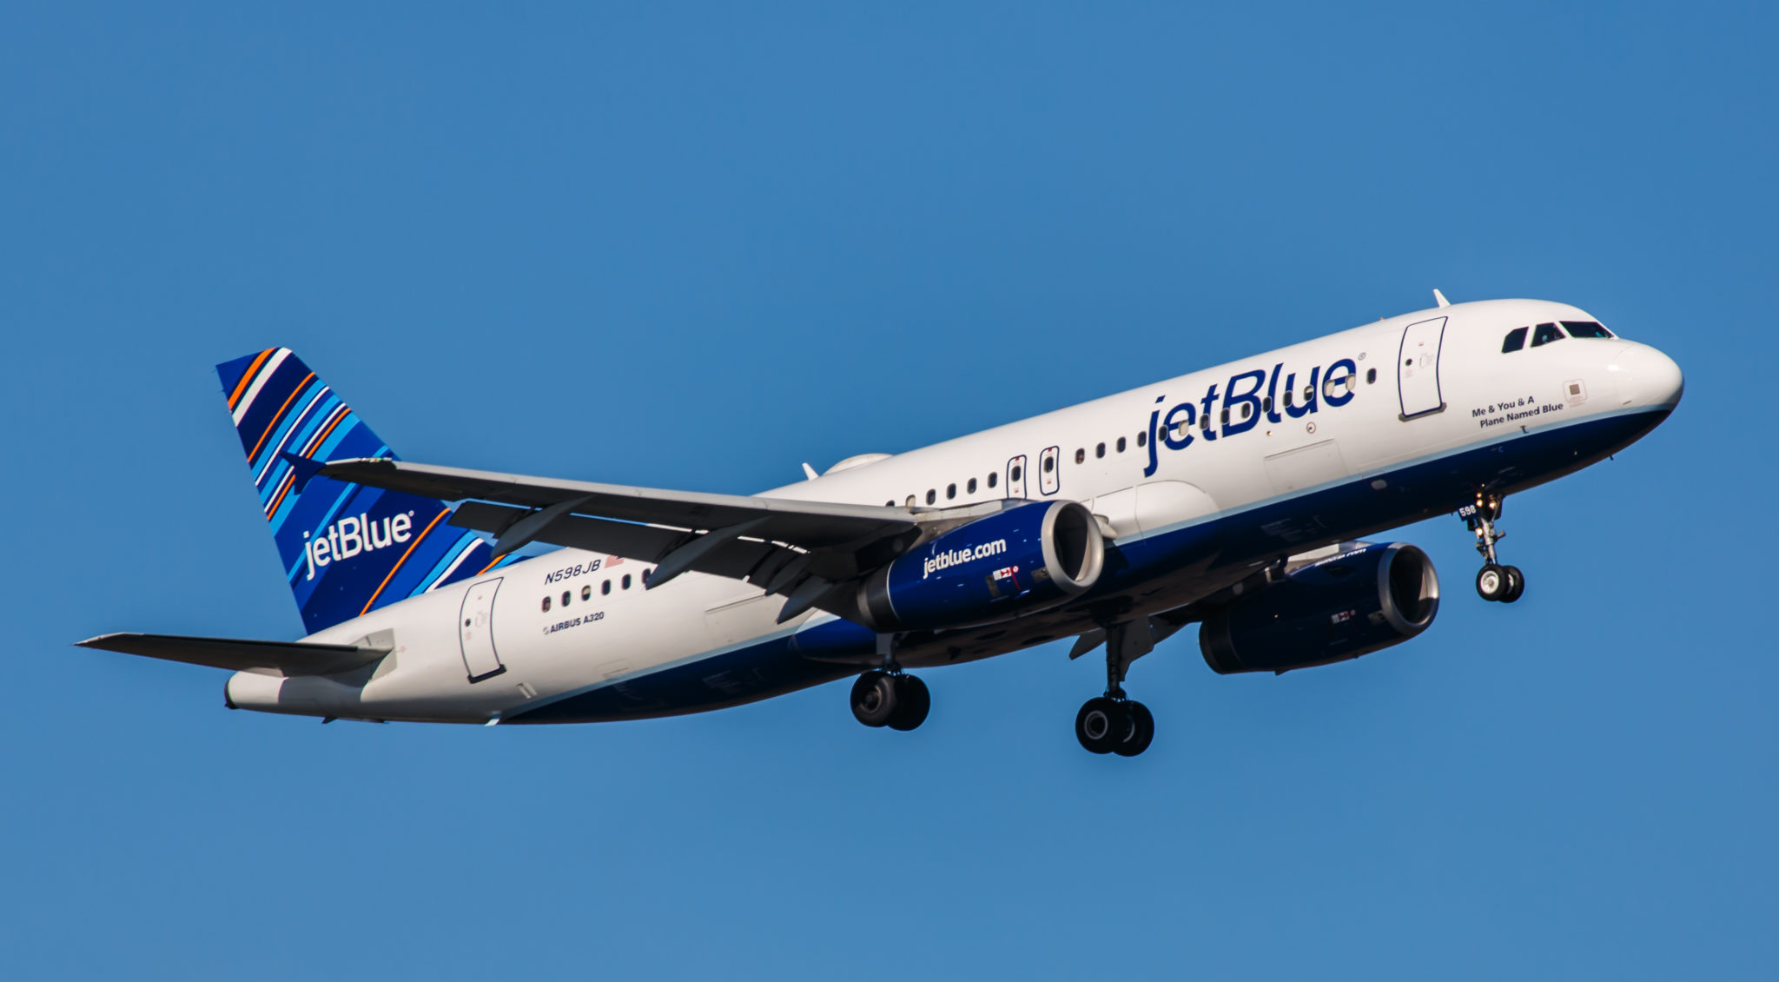
Competition - Airlines
Fast
Bargain price (Low-Cost Carrier)
Airport hassles
Time, energy, and cost getting to and from the airport
JetBlue Airways, American Airlines, United Airlines

Slide 6
Competition - New York to Boston
 | Amtrak | JetBlue Airways
Average Cost | $70-$170 | $74-$210
Average Duration | 3 hours 30 minutes | 1 hour 10 minutes
Extra time for check-in/security | 30 minutes | 1 hour

Slide 7
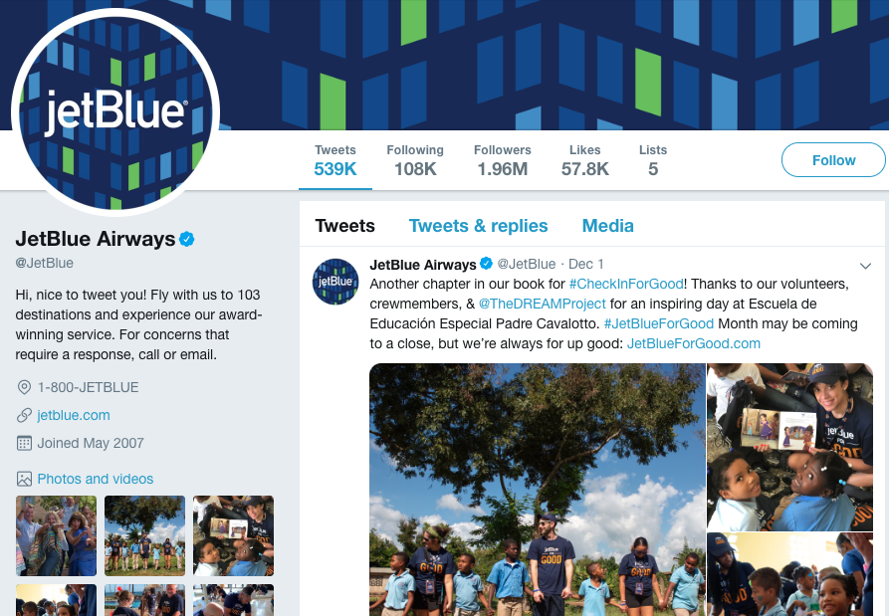
Competition - JetBlue Airways
Brand Marketing: You Above All
Advertising
Sales Promotion
Social Media
Paid Search
Events

Slide 8
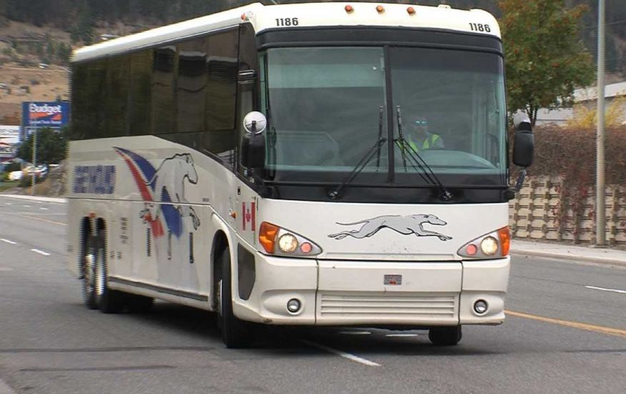
Competition - Bus
Affordable price
Frequent departures
Slower than trains
Unpredictable traffic
Greyhound, Mega Bus, Bolt Bus

Slide 9
Competition - New York to Boston
 | Amtrak | Greyhound
Average Cost | $70-$170 | $25-$57
Average Duration | 3 hours 30 minutes | 4 hour 30 minutes
Extra time for check-in/security | 30 minutes | 30 minutes

Slide 10

Competition - Greyhound
Brand Marketing: You Don't Have to Go Far to Go Far
Return to television for the first time in nearly 20 years
Highlighting unique cities that are not the largest
Aimed at people aged 18-34
Fox, NBC, ABC and CBS
Apple TV and Amazon Fire

Slide 11

Existing Customers
Demographics:
Generation of Baby Boomers, ages 55-64, in northeast urban areas
Use Amtrak primarily for business and personal
Ride Business Class
Profession: Business/Financial Services, 11+ more times of travel a year
Large-sized company 5,000 to 9,999 employees
More senior/executive level
Income $150,000+ with college degree and higher
Breadwinner of family, married, and 1 child
Notes:
Julia Yeung

Slide 12
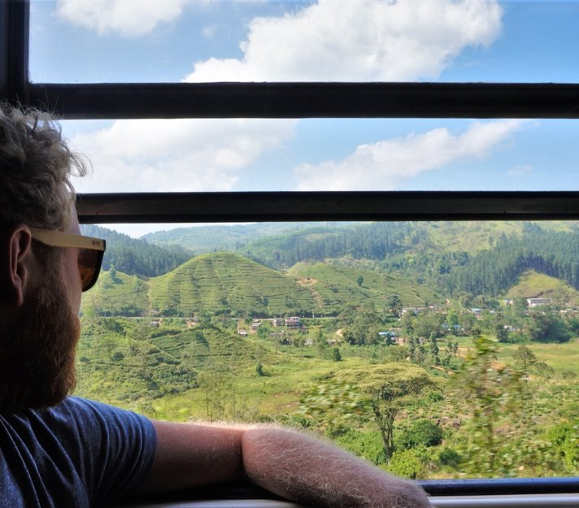
Existing Customers
Psychographics:
Practical and environmentally-conscious individuals
View Amtrak as part of the travel experience
Enjoys seeing the scenery, having peace to think, being part of a community
Enjoy the feel of a collective experience
Prefer comfort over airline hardship
Notes:
Julia Yeung

Slide 13
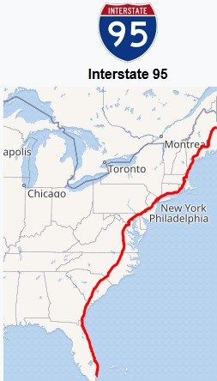
Target Customer #1
Demographics:
Men and Women between ages of 25-34 who travel along I-95 for vacation and personal reasons
Millennials, Graduated college, employed full-time
Income between $60,000 - $75,000, entry to mid-level position
Small to mid-sized company: 50 to 200 employees
Married, own house, at least 2 children
Occupations: Business/Financial Services
Travel 6-10 times per year, usually during holidays and summer months
110 million in northeast region, target 20%, 22 million
Notes:
Julia Yeung

Slide 14

Target Customer #1
Psychographics:
Young and adventurous, care about flexibility and freedom of travel
More financially-conscious
Looking for quality time with family
Prefer to have more comfort in travel due to children
Looking for best deal for their money in terms of comfort, time, and services
Notes:
Julia Yeung

Slide 15
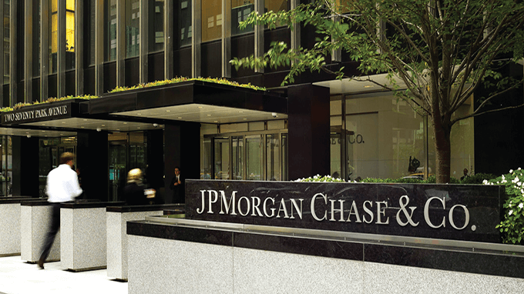
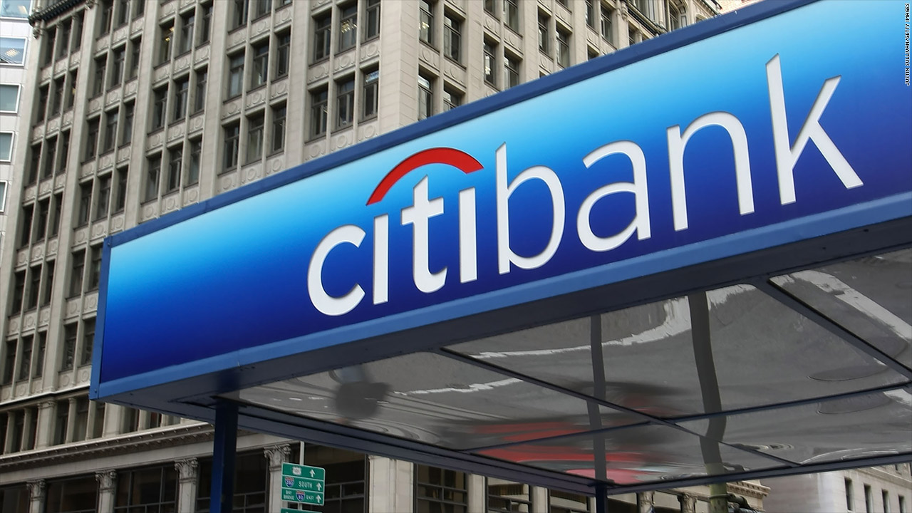
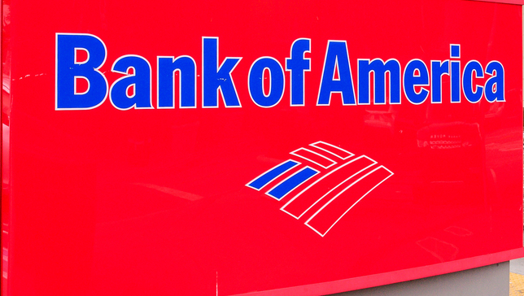
Target Customer #2
Firmographics:
Fortune 500 business/financial services companies who have their employees travel by airplanes and coach buses for meetings/business development along the northeast region
J.P. Morgan, Citigroup, and Bank of America
Ranges from 200,000+ employees
Revenue: $70+ billion
Offices throughout the northeast region
Travel 6-10 times per year
Notes:
Julia Yeung

Slide 16

Target Customer #2
Firm Culture:
Corporate Environment / Global Presence
Being a financial banking company, there are a lot of policy and standards to follow
Care about profitability and efficiency when it comes to travel
Strongly care about business development and interaction between offices
Hierarchy/Bureaucratic organization
Employees often move laterally
Work hard, Play Hard Culture
Notes:
Julia Yeung

Slide 17
Thank You for Your Attention!

Slide 18
Questions?

